Slide 1
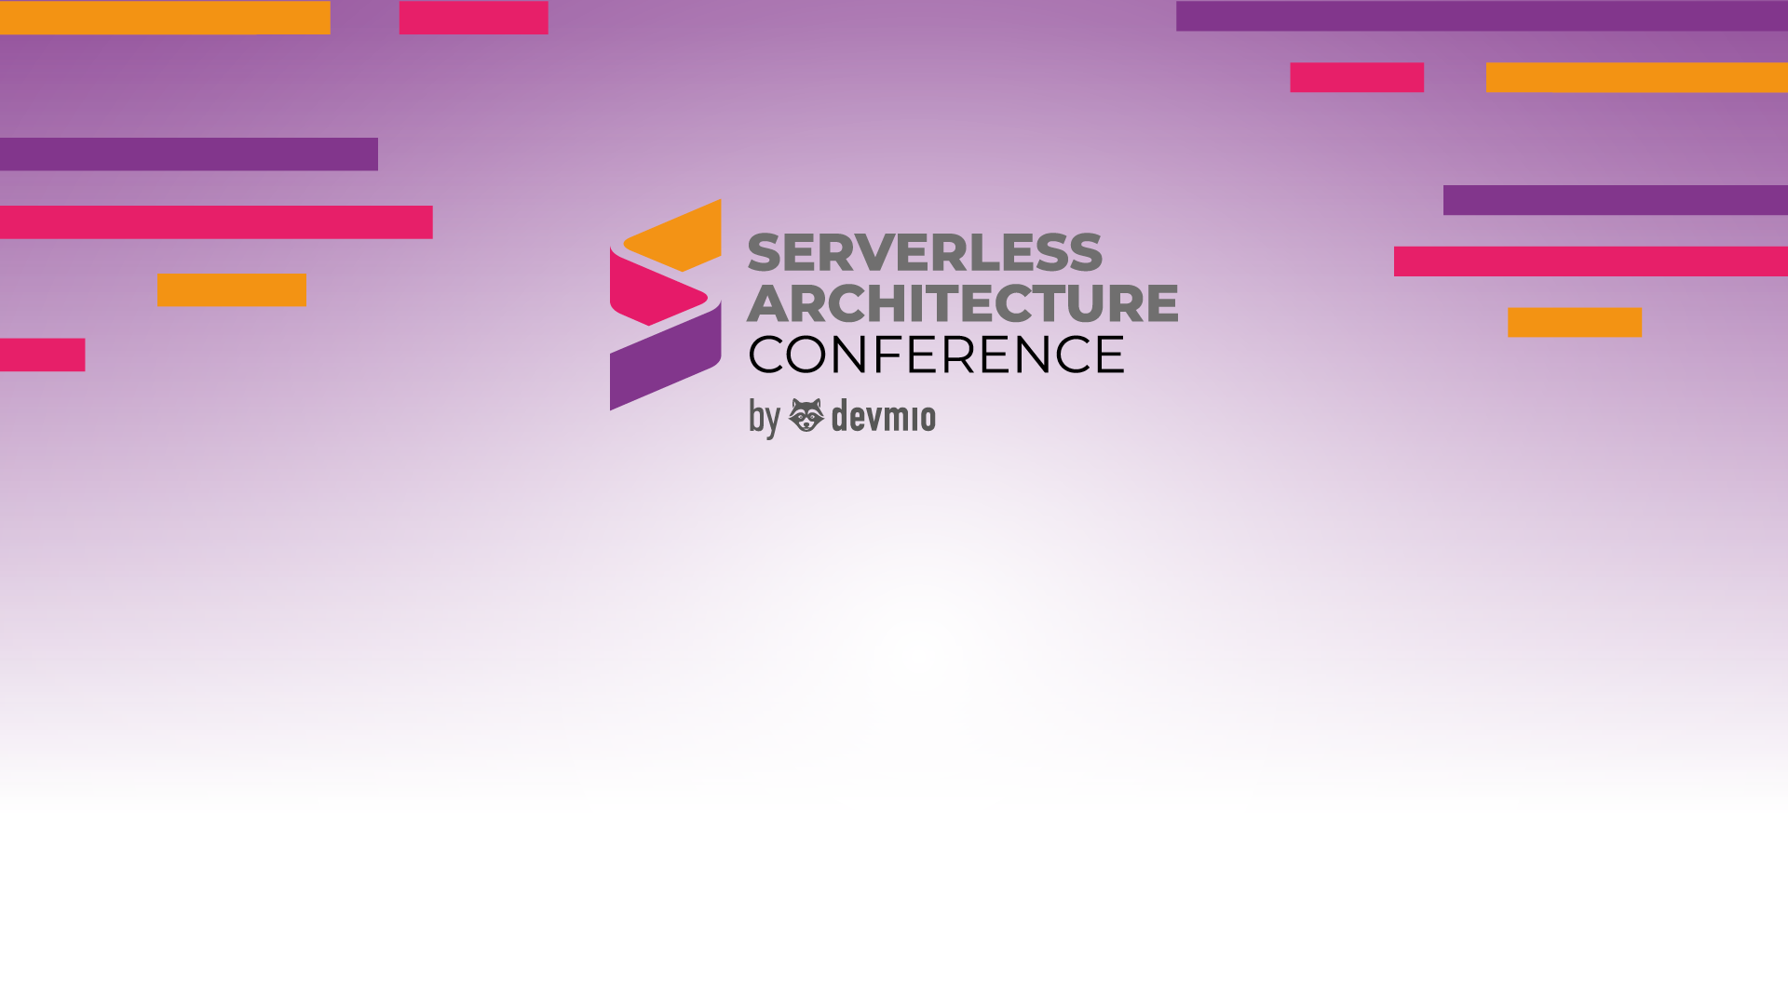
Advanced Serverless Workshop
Advanced Serverless Workshop

Slide 2

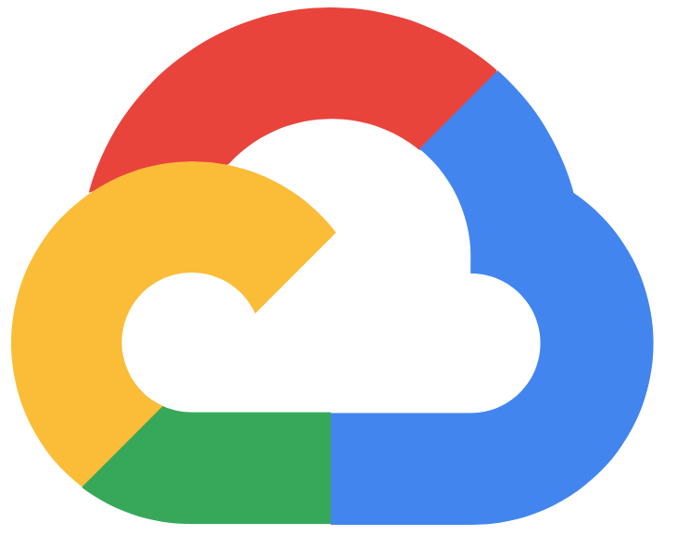

Advanced Serverless Workshop

Slide 3



Speakers
Chad Green
Martine Dowden
Vadym Kazulkin
09:00 to 10:30
11:00 to 12:30
13:30 to 15:00

Slide 4
Speakers
Chad Green
Martine Dowden
Vadym Kazulkin
09:00 to 10:30
11:00 to 12:30
13:30 to 15:00

Slide 5

Panel Session
15:30 to 17:00

Slide 6
Who has a serverless project currently running in production?

Slide 7
Which cloud provider?

Slide 8
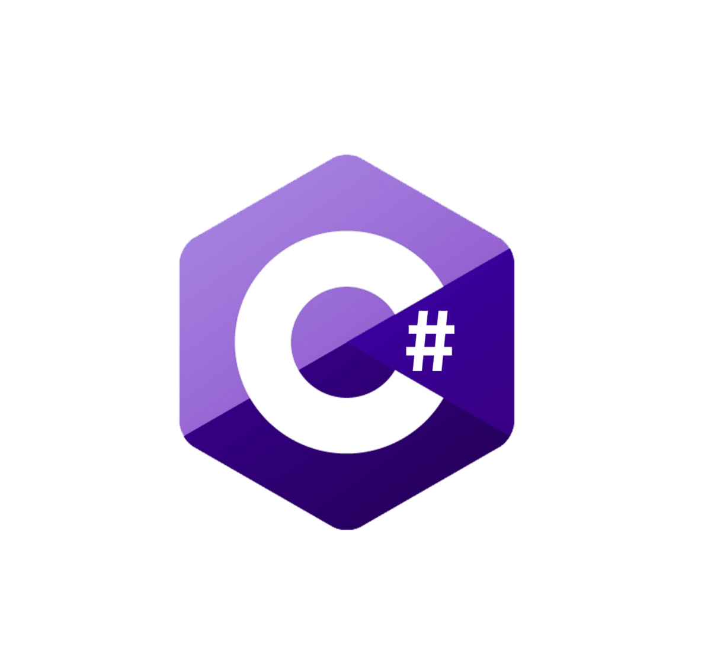






Which language(s)?
Notes:
C#
Java
JavaScript
Node.js
TypeScript
Python
Go

Slide 9
Serverless Unleashed: From Design Patterns to Azure Solutions and Beyond
Advanced Serverless Workshop

Slide 10


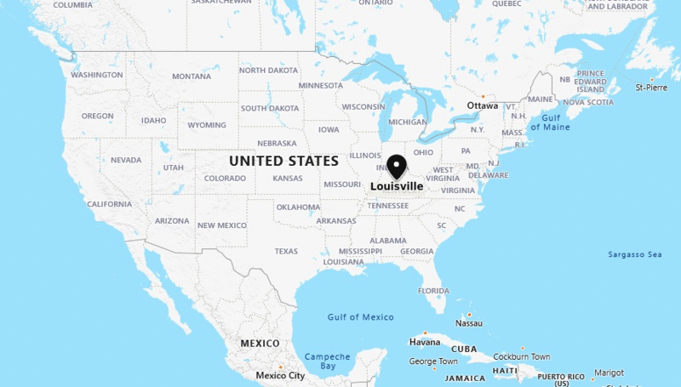

Who is Chad Green?
Notes:
Welcome, my name is Chad Green, and I am the Senior Software Architect at Jasper Engines and Transmissions. I live in Louisville, KY

Slide 11
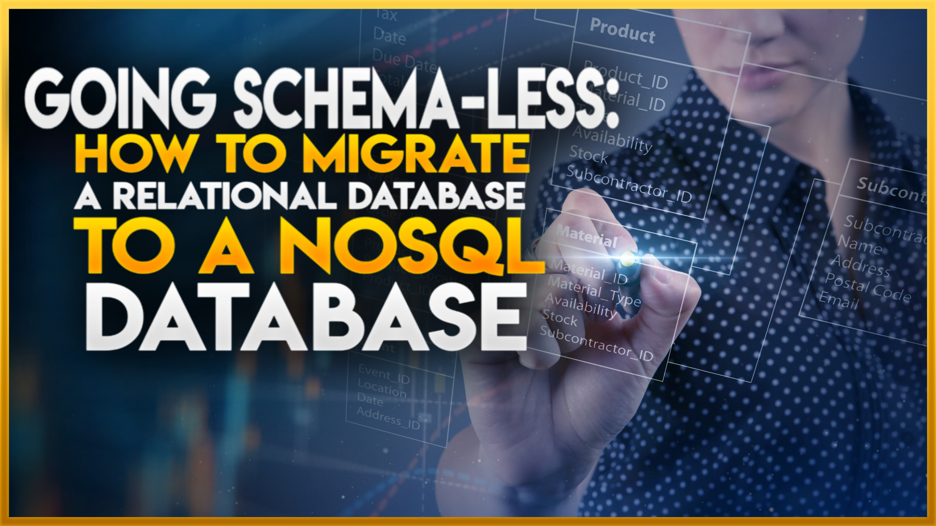




Busy Week
Tuesday @ 11:30
Tuesday @ 15:45
Wednesday @ 17:00

Slide 12
Agenda
Serverless Architecture
Introduction to Serverless Computing
Serverless Architecture Styles
Cloud Design Patterns
Software Design Patterns

Slide 13
Agenda
Serverless Architecture
Azure Services Offerings
Compute
Workflow and Integration
Data Processing and Analytics
Messaging
Data Storage

Slide 14
Agenda
Serverless Architecture
Azure Services Offerings
What’s New and Coming
Recent updates to Azure Container Apps
Upcoming features coming to Azure Functions

Slide 15
Introduction to Serverless Computing
Serverless Unleashed: From Design Patterns to Azure Solutions and Beyond

Slide 16
What is Serverless Computing
On-Prem

Slide 17
What is Serverless Computing
IaaS
Infrastructure as a Service
PaaS
Platform as a Service
FaaS
Function as a Service

Slide 18
What is Serverless Computing
FaaS
Function as a Service
IaaS
Infrastructure as a Service
PaaS
Platform as a Service
Serverless
Notes:
At its core, serverless computing abstracts away the management of servers and infrastructure, allowing developers to execute code in response to events or triggers without provisioning or managing servers. In a serverless model, you pay only for the actual compute resources consumed during the execution of your code, rather than paying for provisioned capacity.

Slide 19
Serverless Benefits
Scalability
Notes:
Serverless platforms automatically scale to handle fluctuations in workload, ensuring optimal performance without manual intervention. This inherent scalability enables applications to accommodate spikes in traffic, scale out to meet growing user demands, and scale in during periods of low activity, all without the need for capacity planning or infrastructure management.

Slide 20
Serverless Benefits
Scalability
Cost-Efficiency
Notes:
One of the most significant benefits of serverless computing is its cost-efficiency. With serverless architectures, you only pay for the compute resources consumed during the execution of your code, eliminating the overhead costs associated with provisioning and maintaining infrastructure. Serverless' pay-as-you-go pricing model ensures that you're only charged for actual usage, making serverless computing a cost-effective solution for applications with unpredictable workloads or fluctuating traffic patterns. By optimizing resource utilization and minimizing idle time, serverless services help organizations reduce their cloud spending and maximize return on investment.

Slide 21
Serverless Benefits
Scalability
Cost-Efficiency
Developer Productivity
Notes:
By abstracting away infrastructure management, serverless frees developers to focus on writing code and building applications. Serverless services enable developers to write code in their preferred programming languages and deploy applications with ease. This streamlined development process accelerates time-to-market, fosters innovation, and enhances developer productivity. With serverless computing, developers can iterate quickly, experiment with new ideas, and deliver value to customers faster than ever before.

Slide 22
Serverless Benefits
Scalability
Cost-Efficiency
Developer Productivity
High Availability
Notes:
Serverless platforms inherently provide high availability and fault tolerance, as they distribute workloads across multiple redundant instances.

Slide 23
Serverless Benefits
Scalability
Cost-Efficiency
Developer Productivity
High Availability
Rapid Development
Notes:
Serverless architectures enable rapid development and deployment of applications, allowing developers to focus on innovation rather than infrastructure management. Developers can build event-driven, microservices-based architectures that scale effortlessly and adapt to changing business needs.
In conclusion, serverless computing offers a myriad of benefits, including scalability, cost-efficiency, developer productivity, high availability, and rapid development. By harnessing the power of serverless architectures, organizations can unlock new opportunities, drive innovation, and achieve their business objectives with greater agility and efficiency.

Slide 24
Implemented Azure Solutions
Serverless Unleashed: From Design Patterns to Azure Solutions and Beyond

Slide 25

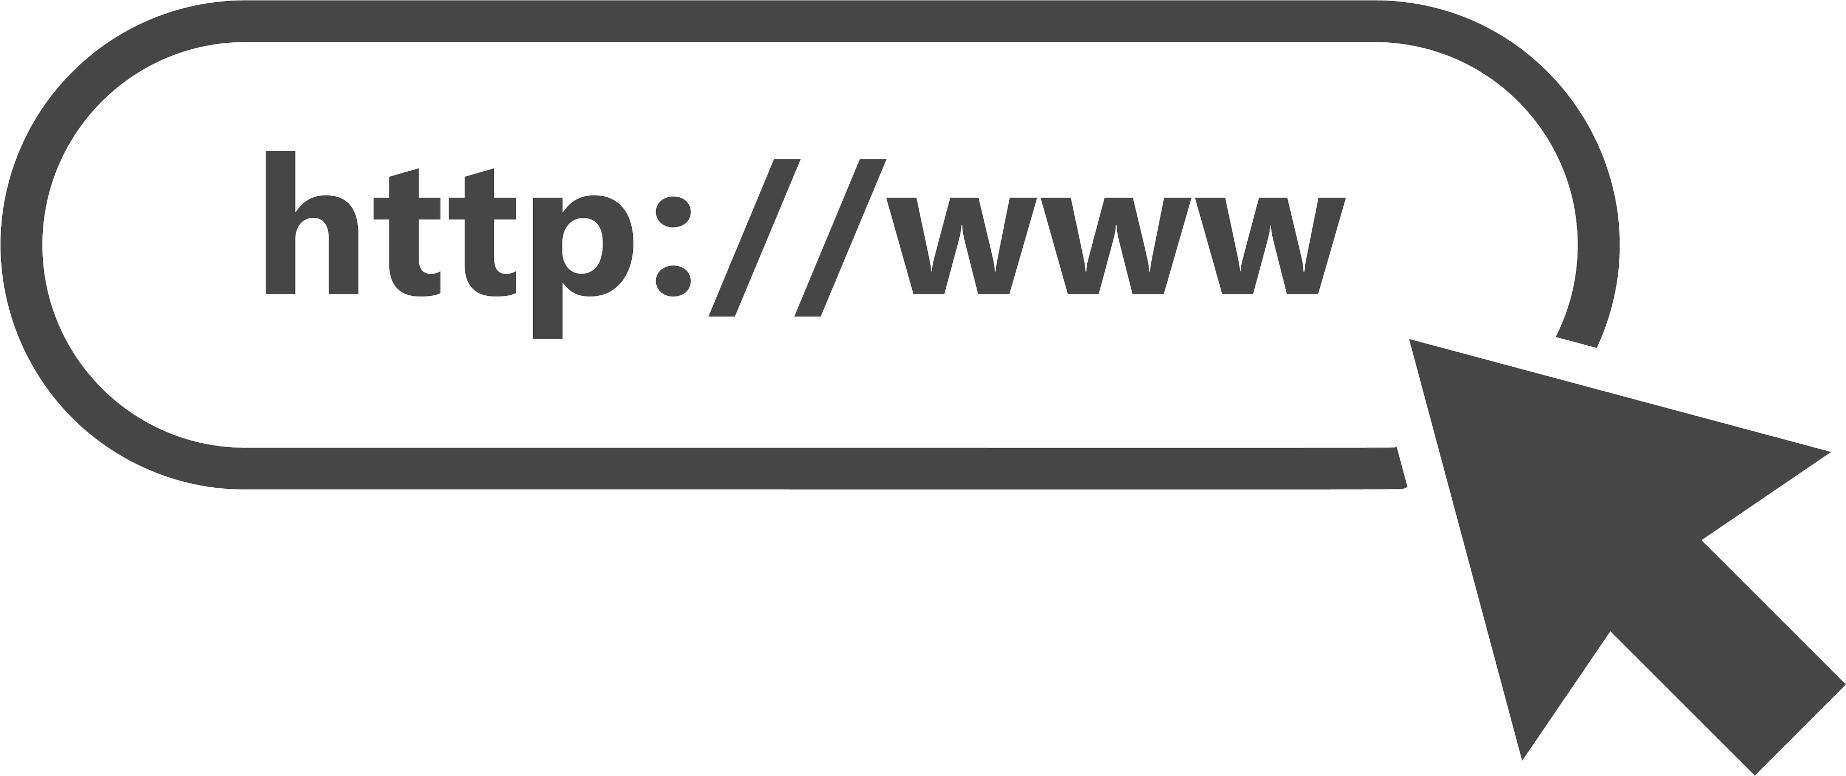


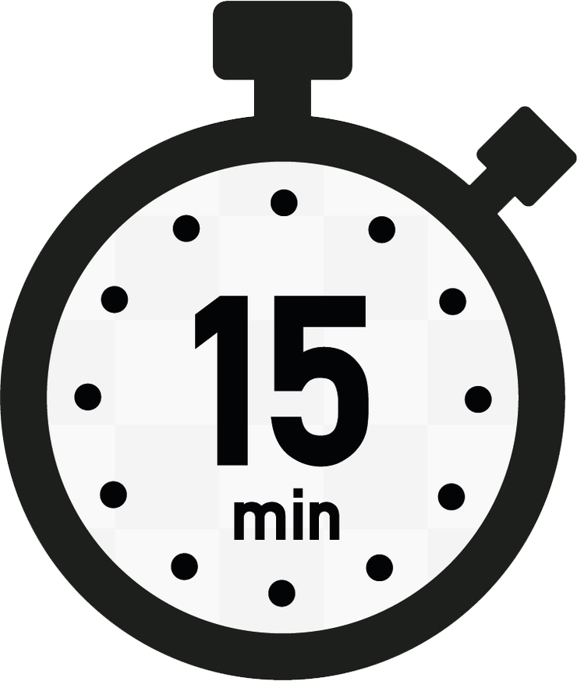
Random Quote Generator
Add Channel
Channels
Add Quote
Quotes
Get Random Quote
Random Quote Timer

Slide 26







Replicating Data
Web
Application
.NET
Services Layer
Primary
Data Store
Change Feed
Monitor
Reporting
Database
Reporting
Dashboard

Slide 27



Real-Time Reporting
Medical Student
Testing
Website
Event
Hub
Stream Analytics
Power BI
Application
Database
Event Monitor
Answers

Slide 28







Property Management & Marketing
Portfolio
Portfolio API
Leasing &
Billing
Customer Legacy
Event Hubs
Serverless API
Customer Applications
Synchronizer
Event Monitor
Image Resizer
Marketing Websites
Queue
Customer
Queue
Portfolio
Marketing API
Chat Bots
Response
Builder
Cached
Responses
API Management
Custom
Marketing API
Google Ads

Slide 29
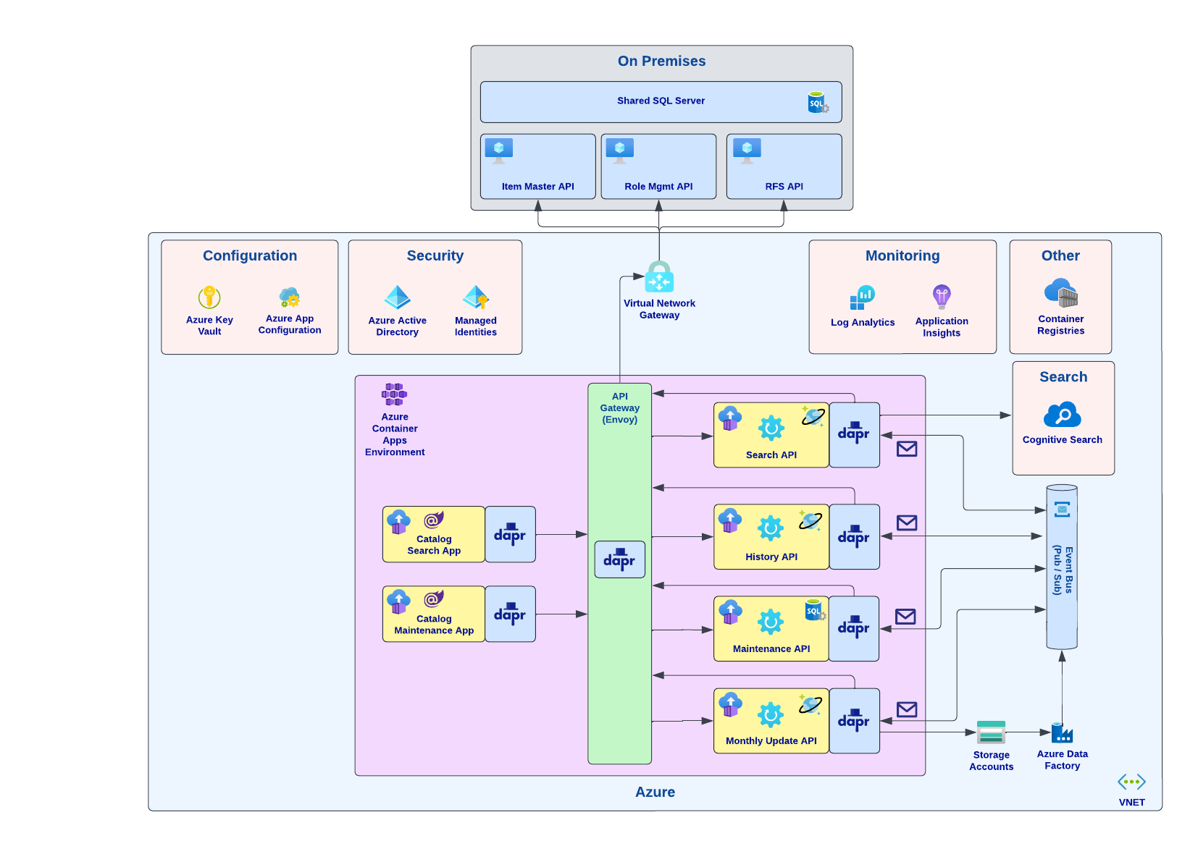
Catalog Maintenance

Slide 30
Serverless Architecture Styles
Serverless Unleashed: From Design Patterns to Azure Solutions and Beyond

Slide 31
Microservices
Client
Microservices
Service
Service
API Gateway
Service
Service
Management/Orchestration
Notes:
Microservices Architecture is a modern architectural style that structures an application as a collection of loosely coupled, independently deployable services that allow for building scalable, maintainable, and resilient applications.
Microservices Architecture breaks down monolithic applications into smaller, manageable services, each responsible for a specific business capability. These services communicate with each other through lightweight protocols, such as HTTP or messaging queues, and can be developed, deployed, and scaled independently. Microservices promote flexibility, scalability, and agility, as they enable teams to work on different services concurrently and adopt technologies best suited for each service.

Slide 32
Benefits of Microservices
Flexibility
Notes:
Microservices Architecture enables teams to work independently on different services, choose technologies best suited for each service, and evolve services independently without impacting other components.

Slide 33
Benefits of Microservices
Flexibility
Scalability
Notes:
Because of the microservices’ flexibility with its ability to have different components using different components, you can use highly-scalable services where needed to handle varying workloads efficiency and cost-effectively.

Slide 34
Benefits of Microservices
Flexibility
Scalability
Resilience
Notes:
By breaking down applications into smaller, isolated services, Microservices Architecture promotes resilience and fault tolerance, as failures in one service do not affect the availability of other services.

Slide 35
Benefits of Microservices
Flexibility
Scalability
Resilience
Agility
Notes:
Microservices Architecture enables rapid development, deployment, and iteration of services, allowing organizations to respond quickly to changing business requirements and market dynamics.

Slide 36
Event-Driven Architecture
Event Consumers
Event Producers
Event Ingestion
Event Consumers
Event Consumers
Notes:
Event-Driven Architecture (EDA) is a powerful paradigm that leverages events to facilitate communication and coordination between various components of a distributed system.
Event-Driven Architecture revolves around the concept of events, which represent significant occurrences or state changes within a system. These events are generated by producers and consumed by consumers, allowing different parts of the system to react to changes in real-time. EDA promotes loose coupling between components, as each component can independently react to events without direct dependencies on other components.

Slide 37
Benefits of Event-Driven Architecture
Scalability
Notes:
Event-driven architectures are excellent at automatically scaling to handle fluctuations in event volumes, ensuring optimal performance and reliability under varying workloa.ds

Slide 38
Benefits of Event-Driven Architecture
Scalability
Flexibility
Notes:
The Event-Driven Architecture enables flexible and decoupled communication between components, allowing for easy integration, evolution, and maintenance of distributed systems.

Slide 39
Benefits of Event-Driven Architecture
Scalability
Flexibility
Resilience
Notes:
By decoupling components and leveraging asynchronous event processing, Event-Driven Architecture promotes resilience and fault tolerance, as failures in one component do not cascade to others.

Slide 40
Benefits of Event-Driven Architecture
Scalability
Flexibility
Resilience
Real-Time Processing
Notes:
Event-Driven Architectures facilitate real-time event processing and analysis, allowing applications to react to events as they occur and make timely decisions based on the latest data.

Slide 41
Workflow Orchestration
Activity 1
Starter
Orchestrator
Activity 2
Activity 3
Notes:
Workflow Orchestration plays a crucial role in coordinating complex business processes and automating tasks across distributed systems. Serverless offerings enable Workflow Orchestration implementation to allow for its significance in streamlining business operations and improving efficiency.
Workflow Orchestration involves the coordination and automation of interconnected tasks, activities, and processes to achieve specific business objectives. It enables organizations to define, execute, and monitor workflows that span multiple systems, services, and resources, ensuring smooth execution and consistent outcomes. Workflow Orchestration is essential for use cases such as order processing, customer onboarding, batch processing, and data integration.

Slide 42
Benefits of Workflow Orchestration
Streamlined Business Processes
Notes:
Serverless services enable organizations to automate and streamline complex business processes, reducing manual effort and improving operational efficiency.

Slide 43
Benefits of Workflow Orchestration
Streamlined Business Processes
Scalability
Notes:
Serverless architectures provide auto-scaling capabilities, allowing organizations to handle varying workloads and scale resources dynamically based on demand, ensuring optimal performance and cost-efficiency.

Slide 44
Benefits of Workflow Orchestration
Streamlined Business Processes
Scalability
Flexibility
Notes:
Serverless offerings can provide a flexible and extensible platform for defining, executing, and monitoring workflows, enabling organizations to adapt to changing business requirements and integrate with diverse systems and services.

Slide 45
Benefits of Workflow Orchestration
Simplified Business Processes
Scalability
Flexibility
Reliability
Notes:
Serverless services are built to provide high availability, fault tolerance, and reliability, ensuring that workflows execute consistently and reliably even in the face of failures or disruptions.

Slide 46
Scalable Web Applications
Content Delivery Network
Blob Storage
HTTP Get
Single-Page Web Application
HTTP Get/Post/Put
API Gateway
FaaS
Data Store
Notes:
Scalable Web Applications are essential for modern businesses, as they must accommodate varying levels of traffic and user demands while maintaining optimal performance and reliability. In this section, we'll explore how Azure's serverless offerings enable the implementation of Scalable Web Applications and their benefits for organizations seeking to deliver robust and responsive online experiences.
Scalable Web Applications are designed to handle fluctuating levels of traffic and user activity by dynamically scaling resources up or down based on demand. These applications leverage cloud-native architectures and technologies to ensure optimal performance, reliability, and cost-efficiency. Scalable Web Applications often adopt serverless principles to abstract away infrastructure management and enable automatic scaling, allowing organizations to focus on delivering value to users without worrying about infrastructure provisioning or capacity planning.

Slide 47
Benefits of Scalable Web Apps
Automatic Scaling
Notes:
As the name implies, scalable web applications automatically scale resources up or down based on demand, ensuring optimal performance and cost-efficiency under varying workloads.

Slide 48
Benefits of Scalable Web Apps
Automatic Scaling
Global Reach
Notes:
When looking at the major cloud vendors and their global infrastructure and content delivery services, scalable web apps are enable to deliver content to users worldwide with low latency and high availability.

Slide 49
Benefits of Scalable Web Apps
Automatic Scaling
Global Reach
Simplified Operation
Notes:
Serverless architectures abstract away infrastructure management, allowing organizations to focus on building and delivering value to users without the overhead of managing servers or provisioning resources.

Slide 50
Benefits of Scalable Web Apps
Automatic Scaling
Global Reach
Simplified Operation
Cost Efficiency
Notes:
With serverless computing, organizations only pay for the resources consumed during the execution of code, resulting in cost savings compared to traditional provisioning models where resources may remain idle during periods of low activity.

Slide 51
Cloud Design Patterns
Serverless Unleashed: From Design Patterns to Azure Solutions and Beyond

Slide 52
Event Sourcing
Presentation
External Systems and Applications
Cart Created
Item 1 Added
Materialized View
Item 2 Added
Item 1 Removed
Shipping Info Added
Event Store
Query for current state of entries
Notes:
Event Sourcing is a powerful pattern used to capture and persist the state of a system as a sequence of events. In this section, we'll explore how Event Sourcing can be implemented in Azure serverless architectures, leveraging Azure's services to achieve reliable, scalable, and efficient event-driven systems.
Event Sourcing is a pattern where the state of a system is derived from a sequence of immutable events. Instead of storing the current state of an entity, Event Sourcing focuses on capturing changes to the state over time as a series of events. These events represent discrete actions or transactions that have occurred within the system and serve as the single source of truth for deriving the current state.

Slide 53
Benefits of Event Sourcing
Immutable Audit Trail
Notes:
Event Sourcing provides a reliable and immutable audit trail of changes to the system's state, enabling traceability, accountability, and compliance with regulatory requirements.

Slide 54
Benefits of Event Sourcing
Immutable Audit Trail
Temporal Queries
Notes:
Serverless computing enable efficient querying and analysis of historical event data, allowing organizations to derive insights, identify trends, and perform temporal analysis of system behavior over time.

Slide 55
Benefits of Event Sourcing
Immutable Audit Trail
Temporal Queries
Scalability and Reliability
Notes:
Serverless services provide scalability, fault tolerance, and high availability, ensuring that event streams are processed reliably and efficiently even under high volumes of traffic.

Slide 56
Benefits of Event Sourcing
Immutable Audit Trail
Temporal Queries
Scalability and Reliability
Flexibility and Extensibility
Notes:
Event Sourcing enables organizations to evolve and extend their systems over time by replaying and reprocessing historical events, introducing new event types, and adding new consumers or processors without disrupting existing workflows.

Slide 57
Command Query Responsibility Segregation (CQRS)
Client
Write
Command
Data Store
Read
Query
Notes:
Command Query Responsibility Segregation (CQRS) is a design pattern that separates the responsibilities of handling commands (write operations) and queries (read operations) into distinct components. In this section, we'll explore how CQRS can be implemented in serverless architectures, leveraging serverless services to achieve scalability, performance, and maintainability in data-intensive applications.
CQRS is a pattern that promotes a clear separation between operations that modify the state of a system (commands) and operations that retrieve information from the system (queries). By segregating these responsibilities, CQRS enables the optimization of data models, workflows, and scalability strategies for read and write operations independently. This separation allows for the use of different data storage and processing strategies for commands and queries, leading to improved performance and flexibility.

Slide 58
Benefits of CQRS
Scalability
Notes:
CQRS enables independent scaling of write and read components, allowing organizations to optimize resource utilization and handle varying workloads more effectively.

Slide 59
Benefits of CQRS
Scalability
Performance
Notes:
By using dedicated storage and processing strategies for commands and queries, CQRS can improve the performance of data operations and reduce latency for read and write requests.

Slide 60
Benefits of CQRS
Scalability
Performance
Flexibility
Notes:
Serverless services provide a flexible and extensible platform for implementing CQRS patterns, allowing organizations to evolve and adapt their architectures over time to meet changing business requirements and user needs.

Slide 61
Benefits of CQRS
Scalability
Performance
Flexibility
Maintainability
Notes:
CQRS promotes a clear separation of concerns between write and read operations, making it easier to understand, test, and maintain complex systems with distinct data access patterns.

Slide 62
Retry
Application
1
Hosted Service
500
2
500
3
200
Notes:
The Retry Pattern is a fundamental design pattern used to enhance the resilience and reliability of distributed systems by automatically retrying failed operations. In this section, we'll explore how the Retry Pattern can be effectively implemented in Azure serverless architectures, leveraging Azure's services to handle transient failures and improve system availability.
The Retry Pattern addresses the transient nature of failures in distributed systems by automatically retrying failed operations with the expectation that the operation may succeed on subsequent attempts. Transient failures, such as network timeouts, resource constraints, and service unavailability, are often temporary and can be resolved by retrying the operation after a brief delay. By incorporating retry logic into applications, organizations can improve fault tolerance, handle temporary disruptions gracefully, and reduce the impact of transient failures on system reliability.

Slide 63
Benefits of Retry
Improved Reliability
Notes:
The Retry Pattern enhances the resilience of serverless architectures by automatically retrying failed operations, increasing the likelihood of successful execution and minimizing service disruptions.

Slide 64
Benefits of Retry
Improved Reliability
Fault Tolerance
Notes:
By incorporating retry logic into applications, organizations can gracefully handle transient failures, recover from temporary disruptions, and maintain system availability in the face of unpredictable failures.

Slide 65
Benefits of Retry
Improved Reliability
Fault Tolerance
Reduced Operational Overhead
Notes:
Serverless offerings provide built-in support for retry policies and error handling, reducing the need for manual intervention and operational overhead in managing transient failures.

Slide 66
Benefits of Retry
Improved Reliability
Fault Tolerance
Reduced Operational Overhead
Enhanced User Experience
Notes:
By transparently retrying failed operations, organizations can deliver a seamless and uninterrupted user experience, minimizing the impact of transient failures on application performance and responsiveness.

Slide 67
Circuit Breaker
Client
Circuit Breaker
Open
Service
Closed
Notes:
The Circuit Breaker Pattern is a crucial design pattern used to enhance the resilience and stability of distributed systems by detecting and handling faults in remote services. In this section, we'll explore how the Circuit Breaker Pattern can be effectively implemented in Azure serverless architectures, leveraging Azure's services to mitigate the impact of failures and improve system reliability.
The Circuit Breaker Pattern is inspired by electrical circuit breakers, which interrupt the flow of electricity when a fault is detected to prevent damage to the electrical system. Similarly, in software design, the Circuit Breaker Pattern monitors remote service calls and trips the circuit when a certain threshold of failures is reached. Once the circuit is open, subsequent calls to the remote service are bypassed, reducing the load on the service and preventing cascading failures. After a predefined cooldown period, the circuit may be closed again to allow normal operation.

Slide 68
Benefits of Circuit Breaker
Fault Tolerance
Notes:
The Circuit Breaker Pattern enhances the resilience of serverless architectures by detecting and handling faults in remote service calls, preventing cascading failures, and maintaining system availability under adverse conditions.

Slide 69
Benefits of Circuit Breaker
Fault Tolerance
Load Management
Notes:
By tripping the circuit during periods of high error rates or service unavailability, the Circuit Breaker Pattern helps manage load on downstream services, reducing the risk of overloading and improving overall system stability.

Slide 70
Benefits of Circuit Breaker
Fault Tolerance
Load Management
Improved User Experience
Notes:
By gracefully degrading functionality and failing fast during service outages, the Circuit Breaker Pattern ensures a smoother and more predictable user experience, minimizing the impact of failures on application performance and responsiveness.

Slide 71
Benefits of Circuit Breaker
Fault Tolerance
Load Management
Improved User Experience
Operational Insights
Notes:
Serverless offerings provide monitoring and logging capabilities that enable organizations to gain insights into the health and performance of circuit breaker implementations, allowing for proactive troubleshooting and optimization.

Slide 72
External Configuration
Serverless Component
Data Store
External Configuration Store
Serverless Component
External Service
Serverless Component
Local Cache
Notes:
The External Configuration Store pattern is a fundamental design pattern used to centralize and manage application configuration settings outside of the codebase. In this section, we'll explore how the External Configuration Store pattern can be effectively implemented in Azure serverless architectures, leveraging Azure's services to achieve greater flexibility, security, and scalability in managing application configurations.
In traditional software development practices, application configurations are often hardcoded within the codebase, making them difficult to manage, update, and maintain. The External Configuration Store pattern addresses this challenge by decoupling configuration settings from the application code and storing them in an external repository or service. By externalizing configurations, organizations can achieve greater flexibility, agility, and security in managing application settings, allowing for dynamic configuration updates without the need for code changes or redeployments.

Slide 73
Benefits of External Configuration
Centralized Management
Notes:
The External Configuration Store pattern enables organizations to centralize and manage application configurations in a single repository, simplifying configuration management and ensuring consistency across environments.

Slide 74
Benefits of External Configuration
Centralized Management
Dynamic Configuration Updates
Notes:
Serverless offerings support dynamic updating of configuration settings, allowing organizations to update application configurations in real-time without requiring code changes or application redeployments, reducing downtime and improving agility.

Slide 75
Benefits of External Configuration
Centralized Management
Dynamic Configuration Updates
Enhanced Security
Notes:
By storing sensitive configuration settings and credentials in secure services, organizations can ensure data protection, compliance, and confidentiality, mitigating the risk of unauthorized access or data breaches.

Slide 76
Benefits of External Configuration
Centralized Management
Dynamic Configuration Updates
Enhanced Security
Scalability and Performance
Notes:
Serverless services provide scalable and high-performance storage solutions for storing configuration settings, ensuring fast and reliable access to application configurations even under high loads or peak traffic.

Slide 77
Other Cloud Design Patterns
Ambassador
Anti-Corruption Layer
Asynchronous Request-Retry
Backends for Frontends
Bulkhead
Cache-Aside
Choreography
Claim Check
Compensating Transactions
Competing Consumers
Compute Resource Consolidation
Deployment Stamps
Edge Workload Configuration
Federated Identity
Gatekeeper
Gateway Aggregation
Gateway Offloading
Gateway Routing
Geode
Health Endpoint Monitoring
Index Table
Leader Execution
Materialized View
Pipes and Filters
Priority Queue
Publisher/Subscriber
Queue-Based Load Balancing
Rate Limiting
Saga
Scheduler Agent Supervisor
Sequential Convoy
Sharding
Static Content Hosting
Stranger Fig
Throttling
Valet Key

Slide 78
Software Design Patterns
Serverless Unleashed: From Design Patterns to Azure Solutions and Beyond

Slide 79
Function Composition
Complex Task
Function
Function
Function
Notes:
Function Composition is a crucial software design pattern that focuses on building complex functionalities by composing smaller, independent functions together. In this section, we'll explore how Function Composition can be effectively applied in Azure serverless architectures to create modular, scalable, and maintainable solutions.
Function Composition involves breaking down complex tasks into smaller, more manageable functions and then composing these functions together to achieve the desired functionality. Each function performs a specific task or operation, and by composing them together, developers can create more sophisticated behaviors without introducing complexity or dependencies. Function Composition promotes code reusability, modularity, and testability, making it a powerful design pattern for building scalable and maintainable applications.

Slide 80
Benefits of Function Composition
Modularity
Notes:
Function Composition promotes modularity by breaking down complex tasks into smaller, reusable functions, making it easier to understand, test, and maintain codebases.

Slide 81
Benefits of Function Composition
Modularity
Scalability
Notes:
Azure's serverless offerings enable individual functions to scale independently based on demand, allowing developers to compose functions together to build scalable and responsive applications.

Slide 82
Benefits of Function Composition
Modularity
Scalability
Flexibility
Notes:
Function Composition allows developers to compose functions together dynamically, enabling them to adapt and evolve their applications over time to meet changing business requirements and user needs.

Slide 83
Benefits of Function Composition
Modularity
Scalability
Flexibility
Testability
Notes:
Serverless services provide scalable and high-performance storage solutions for storing configuration settings, ensuring fast and reliable access to application configurations even under high loads or peak traffic.

Slide 84
Saga Pattern
Step 1
Step 2
Step 3
Message
Message
Data Store
Notes:
The Saga Pattern is a crucial software design pattern used to maintain data consistency and reliability in distributed systems with long-running transactions. In this section, we'll explore how the Saga Pattern can be effectively applied in Azure serverless architectures to manage complex, multi-step workflows and ensure transactional integrity.
The Saga Pattern is designed to address the challenges of managing distributed transactions across multiple services or components in a distributed system. Instead of relying on traditional two-phase commit protocols, which can introduce bottlenecks and increase the risk of transaction failures, the Saga Pattern breaks down long-running transactions into smaller, loosely coupled steps or "sagas." Each saga represents a discrete unit of work or a transactional step, and by coordinating the execution of sagas, developers can ensure transactional integrity and reliability across distributed systems.

Slide 85

Benefits of Saga Pattern
Transactional Integrity
Notes:
The Saga Pattern ensures transactional integrity and consistency across distributed systems by breaking down long-running transactions into smaller, atomic steps or sagas, and coordinating their execution to maintain data consistency.

Slide 86
Benefits of Saga Pattern
Transactional Integrity
Fault Tolerance
Notes:
By decoupling sagas and allowing them to execute independently, the Saga Pattern provides fault tolerance and resilience against failures in distributed systems, ensuring that partial failures do not compromise the integrity of the overall transaction.

Slide 87
Benefits of Saga Pattern
Transactional Integrity
Fault Tolerance
Scalability
Notes:
Azure's serverless offerings, such as Durable Functions, enable individual sagas to scale independently based on demand, allowing developers to orchestrate complex workflows and transactions at scale without introducing bottlenecks or performance issues.

Slide 88
Benefits of Saga Pattern
Transactional Integrity
Fault Tolerance
Scalability
Flexibility
Notes:
The Saga Pattern allows developers to define sagas dynamically and evolve their workflows over time to accommodate changing business requirements and user needs, providing flexibility and adaptability in Azure serverless architectures.

Slide 89
Event Driven Pattern
Producer
Ingestion
Consumer
Notes:
Event-Driven Microservices is a fundamental software design pattern that emphasizes loose coupling and scalability by enabling communication between microservices through asynchronous events. In this section, we'll explore how Event-Driven Microservices can be effectively implemented in Azure serverless architectures to build scalable, resilient, and loosely coupled systems.
Event-Driven Microservices architecture revolves around the idea of microservices communicating with each other through asynchronous events. Instead of direct synchronous communication between services, microservices produce and consume events that represent meaningful business activities or state changes. This approach promotes loose coupling, as microservices are unaware of each other's existence and can evolve independently. Additionally, it enhances scalability and resilience by decoupling the timing and availability of services.

Slide 90
Benefits of Event-Driven Pattern
Loose Coupling
Notes:
Event-Driven Microservices promote loose coupling between services, as they communicate through asynchronous events rather than direct dependencies. This allows services to evolve independently and facilitates easier maintenance and scalability.

Slide 91
Benefits of Event-Driven Pattern
Loose Coupling
Scalability
Notes:
By decoupling services and allowing them to react to events asynchronously, Event-Driven Microservices architectures can scale horizontally to handle varying workloads and spikes in demand more effectively.

Slide 92
Benefits of Event-Driven Pattern
Loose Coupling
Scalability
Resilience
Notes:
Event-Driven Microservices architectures are inherently more resilient to failures, as they can gracefully handle service outages, retries, and transient errors without impacting the overall system. This improves the reliability and availability of applications built on Azure serverless architectures.

Slide 93
Benefits of Event-Driven Pattern
Loose Coupling
Scalability
Resilience
Flexibility
Notes:
Event-Driven Microservices provide flexibility in designing workflows and business processes, as services can be composed and orchestrated dynamically based on event triggers. This enables developers to implement complex, event-driven workflows in a scalable and adaptable manner.

Slide 94
Asynchronous Messaging
Client
Message Broker
Service
Notes:
The Asynchronous Messaging pattern is a fundamental design pattern used to decouple communication between components in a distributed system by exchanging messages asynchronously. In this section, we'll explore how the Asynchronous Messaging pattern can be effectively applied in Azure serverless architectures to improve scalability, reliability, and flexibility.
In traditional synchronous communication, components interact directly, leading to tight coupling and potential scalability and reliability issues. Asynchronous Messaging addresses these challenges by introducing message queues or channels between components. Instead of communicating directly, components send messages to these channels, allowing them to operate independently and asynchronously. This pattern promotes loose coupling, improves scalability, and enhances fault tolerance by decoupling the timing and availability of components.

Slide 95
Benefits of Asynchronous Messaging
Loose Coupling
Notes:
Asynchronous Messaging promotes loose coupling between components by decoupling their communication through message queues or channels. This allows components to operate independently, making it easier to maintain, scale, and evolve the system over time.

Slide 96
Benefits of Asynchronous Messaging
Loose Coupling
Scalability
Notes:
By decoupling components and allowing them to process messages asynchronously, Asynchronous Messaging architectures can scale horizontally to handle varying workloads and spikes in demand more effectively.

Slide 97
Benefits of Asynchronous Messaging
Loose Coupling
Scalability
Reliability
Notes:
Asynchronous Messaging architectures are inherently more resilient to failures, as they can handle transient errors, retries, and service outages without impacting the overall system. This improves the reliability and availability of applications built on Azure serverless architectures.

Slide 98
Benefits of Asynchronous Messaging
Loose Coupling
Scalability
Reliability
Flexibility
Notes:
Asynchronous Messaging provides flexibility in designing workflows and business processes, as components can communicate indirectly through message queues or channels. This enables developers to implement complex, event-driven architectures that are scalable, adaptable, and responsive to changing business requirements.

Slide 99
Microsoft Azure Serverless Services
Serverless Unleashed: From Design Patterns to Azure Solutions and Beyond

Slide 100
Categories
Compute
Workflow and Integration
Data Processing and Analytics
Messaging
Data Storage

Slide 101

Compute
Azure Container Apps
Azure Functions
Notes:
Azure Functions: Event-driven serverless compute service that lets you run event-triggered code without having to explicitly provision or manage infrastructure.
Azure Logic Apps: Provides a way to automate workflows and integrate apps, data, systems, and services across organizations.

Slide 102


Workflow and Integration
Azure Logic Apps
API Management
Azure Event Grid

Slide 103


Data Processing and Analytics
Azure Event Hubs
Azure Stream Analytics
Azure Synapse Analytics
Azure Data Lake Analytics
Notes:
Azure Stream Analytics: Real-time analytics on streaming data.
Azure Data Lake Analytics: On-demand analytics service that simplifies big data processing.
Azure Synapse Analytics (formerly SQL Data Warehouse): Enterprise data warehouse service used to analyze large volumes of data.
Azure Event Hubs: Highly scalable data streaming platform and event ingestion service.

Slide 104


Messaging
Azure Service Bus
Azure Event Hubs
Azure Relays
Azure Event Grid
Azure Storage Queues

Slide 105

Data Storage
Azure SQL Database
Azure Cosmos DB
Azure Storage
Notes:
Azure Stream Analytics: Real-time analytics on streaming data.
Azure Data Lake Analytics: On-demand analytics service that simplifies big data processing.
Azure Synapse Analytics (formerly SQL Data Warehouse): Enterprise data warehouse service used to analyze large volumes of data.
Azure Event Hubs: Highly scalable data streaming platform and event ingestion service.

Slide 106
Azure Functions
Asynchronous Request-Reply
Backends for Frontends
Compute Resource Consolidation
Gatekeeper
Messaging Bridge
Pipes and Filters
Publisher/Subscriber
Queue-Based Load Balancing
Retry
Scheduler Agent Supervisor
Throttling

Slide 107
Azure Container Apps
Ambassador
Backends for Frontends
Bulkhead
Circuit Breaker
Gateway
Gateway Aggregation
Gateway Offloading
Gateway Routing
Pipes and Filters
Sidecar
Stranger Fig

Slide 108
Azure Service Bus
Asynchronous Request-Reply
Competing Consumers
Event Sourcing
Messaging Bridge
Publisher/Subscriber
Queue-Based Load Leveling
Retry
Saga
Sequential Convoy

Slide 109
Azure Event Hubs
Event Sourcing
Messaging Bridge
Publisher/Subscriber
Queue-Based Load Leveling

Slide 110
Azure Event Grid
Asynchronous Request-Reply
Event Sourcing
Messaging Bridge
Publisher/Subscriber

Slide 111
Azure API Management
Ambassador
Anti-Corruption Layer
Backends for Frontends
Gatekeeper
Gateway Aggregation
Gateway Offloading
Gateway Routing
Pipe and Filters
Static Content Hosting
Valet Key

Slide 112
New and Upcoming Serverless Compute Enhancements
Serverless Unleashed: From Design Patterns to Azure Solutions and Beyond

Slide 113
Azure Functions on Azure Container Apps
Run Functions in Containers
Event-Driven Scaling
Open-Source Integration
Flexible Deployment
Monitoring and Networking
Notes:
Azure Functions on Azure Container Apps allows you to deploy and run your serverless functions within a containerized environment1. This setup enables seamless integration with other cloud-native microservices, APIs, and workflows2. By using Azure Container Apps, you can:
Run Functions in Containers: Your functions run in Linux containers, which are managed by Azure Functions.
Event-driven Scaling: Utilize Kubernetes Event-driven Autoscaling (KEDA) for scaling based on event triggers.
Open-source Integration: Leverage open-source tools like Dapr for state management and sidecar capabilities.
Flexible Deployment: Deploy your function app containers from a container registry and use Azure Functions client tools for management.
Monitoring and Networking: Use Application Insights for monitoring and access virtual networking resources provided by the environment.
This setup is ideal for developers looking to build event-driven, cloud-native applications with the flexibility to run functions alongside other containerized services4.

Slide 114
Why Azure Functions on Azure Container Apps?
Integration with Kubernetes
Event-Driven Autoscaling
Open-Source Tools
Cost Efficiency
Flexible Deployment
Notes:
Integration with Kubernetes: Azure Container Apps is built on Kubernetes, which allows for seamless integration with other containerized services and microservices.
Event-driven Autoscaling: With Kubernetes Event-driven Autoscaling (KEDA), you can scale your functions based on event triggers, which is ideal for event-driven architectures.
Open-source Tools: You can leverage open-source tools like Dapr for state management and sidecar capabilities, enhancing your application's functionality.
Cost Efficiency: Running functions in Azure Container Apps can be more cost-effective, especially if you need to integrate with virtual networks.
Flexible Deployment: You can deploy your function app containers from a container registry and manage them using Azure Functions client tools.

Slide 115









Building anything with a unified platform
.NET
Cloud
Web
Desktop
Mobile
Gaming
IoT
AI
+
+
Visual Studio
Visual Studio Code
CLI
Linux
NuGet
GitHub
Integrations, tools, library vendors
Windows
macOS
Tools
Operating system
Ecosystem
Notes:
.NET’s goal is to be a unified development platform that developers love and businesses trust.
It enables developers to build any kind of application with best-in-class runtime, programming languages, development tools, and a vast ecosystem that is powered by amazing developers around the world.”
You can any type of application across web, mobile, desktop, cloud, and more while infusing them with AI and building them across any operating system and a wide range of tools and a great command line.

Slide 116
What every app needs
Every App Needs
Observability
Resiliency
Scalability
Manageability
Notes:
No matter what type of application you're building every single application needs to be observable to get deep insights while you're debugging your application and while it's out into production. Additionally, they need to be resilient which means that no matter what the Internet connectivity is or the environment they need to be always up and running not only on the front end but also on the back end. They have to be scalable your application today much of serve a few 100 people but what happens when it serves 10s of thousands or hundreds of thousands of users. And finally, as a developer we want to be able to easily manage our application and easily deploy them so we can continuously and rapidly iterate on our apps.

Slide 117
.NET 8 Includes
Observability
Resiliency
Scalability
Manageability
Built in metrics with dimensions
New Polly based resiliency packages
AOT (increased density)
Certificate auto-rotation support in Kestrel
DI integration for metrics
SignalR Stateful Reconnect
Performance
Better Logging support (faster, can object serialization)
Chiseled Ubuntu
Enrichment
Redaction
Testing fakes for Logging & Metrics
Notes:
Now inside of .NET you have the ability to not only build these applications but integrate into all of these different parts and in .NET eight the team added even more goodness across all of these different key areas for developers. This means at your fingertips you can easily integrate different NuGet packages and services from the frameworks into your applications to make them more observable resilient scalable and manageable in the long run.

Slide 118
It’s still not easy
It’s Still Not Easy 🙁
Complex
Getting Started
Choices
Paved Path
Notes:
And even though a lot of this is included directly into the SDK and additional packages, it doesn't mean it's necessarily easy because applications as we build them out and get more complex as they go So what this means is that as developers we have a lot of choices to pick we don't necessarily always have the best knowledge of where exactly to get started because of those choice options and as a .NET developer wouldn't it just be great if we had a paved path or a recommended path to do this with our applications.

Slide 119
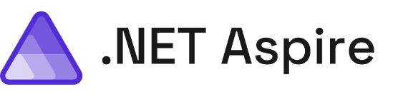
A cloud ready stack for building observable, production ready, distributed applications
Notes:
And that is why the team built .NET Aspire it's a cloud ready stack for building observable, production ready, distributed applications and to help us be more productive as developers when we're developing and deploying our applications.

Slide 120
A cloud ready stack for building observable, production ready, distributed applications
Smart Defaults
Developer Dashboard
Orchestration
Service Discovery
Integrations
Deployment
Notes:
So what's in .NET Aspire? There's a series of different features that help developers be more productive, build better observable production ready distributed applications, and ease the deployment in many scenarios for us. We're going to take a look at every single one of these different features from start to finish and integrate them into our application. Now a lot of people start with the developer dashboard because it's the fancy shiny thing that ships directly with .NET Aspire but we're going to start in a different area first which I think is one of the areas and features that every single application should integrate into our application today

Slide 121
A cloud ready stack for building observable, production ready, distributed applications
Smart Defaults
Developer Dashboard
Orchestration
Service Discovery
Integrations
Deployment
Notes:
So what exactly are smart defaults?

Slide 122
.NET Aspire Service Defaults
Observability
Resiliency
Health Checks
Notes:
Well, there are several things that every single type of application needs, and they're integrated directly into the .NET SDK or packages. If you want to go ahead and configure all of these yourselves you totally can and many applications today might add one or two of these different areas but with smart defaults with one single project added into your solution, you will be able to integrate in a set of defaults are recommended by the asp.NET core team into your applications let's see what that means.

Slide 123
Developer Dashboard
A cloud ready stack for building observable, production ready, distributed applications
Smart Defaults
Developer Dashboard
Orchestration
Service Discovery
Integrations
Deployment
Notes:
Now with our application all set up with smart defaults and starting to generate things such as metrics and traces and telemetry the next thing that we want to do as a developer is get insight into our application as it's running and also better manageability.

Slide 124
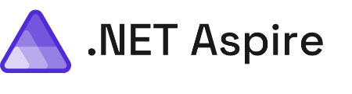
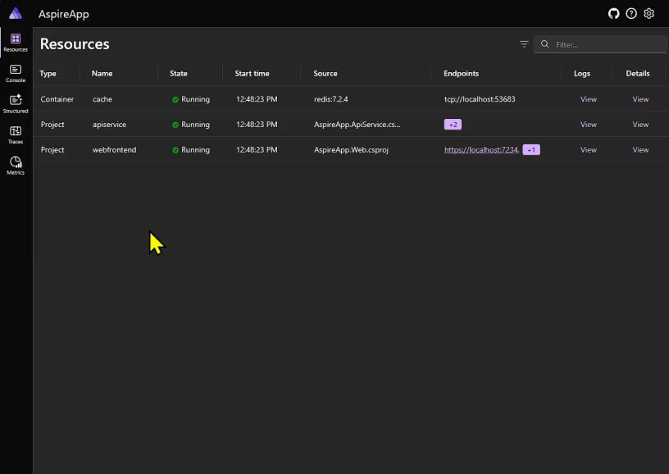
Developer Dashboard
Structured Logs
Metrics
Distributed Traces
Dependencies

Slide 125
A cloud ready stack for building observable, production ready, distributed applications
Smart Defaults
Developer Dashboard
Orchestration
Service Discovery
Integrations
Deployment
Notes:
As I mentioned, orchestration is one of the main feature of .NET Aspire. But what does that look like in practice?

Slide 126
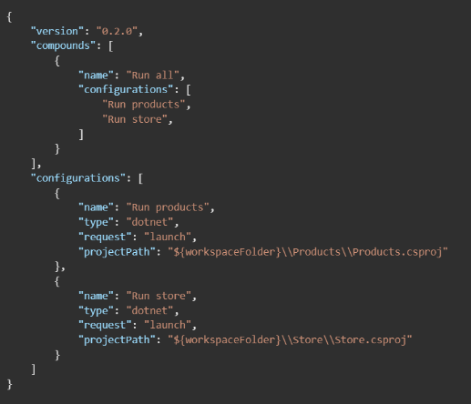
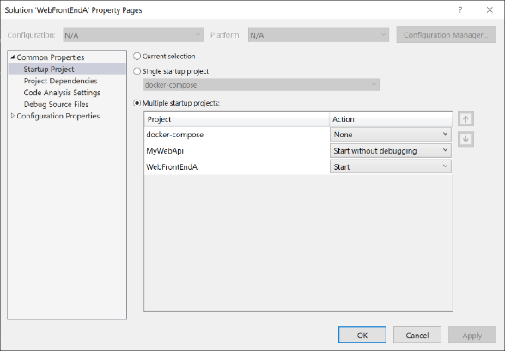
Orchestration Before
Notes:
So currently today and as you just saw if we wanted to run multiple services all at the same time and debug them we're going to have to run multiple commands or configure VS Code or Visual Studio to set up multiple startup projects. Additionally, if we have other dependencies such as this case maybe a database or another container, we're going to also have to spin them up automatically.

Slide 127
Orchestration with .NET Aspire
Orchestration
var builder = DistributedApplication.CreateBuilder(args);
builder.AddProject<Projects.ApiService>("apiservice");
builder.AddProject<Projects.Web>("webfrontend");
builder.Build().Run();

Slide 128
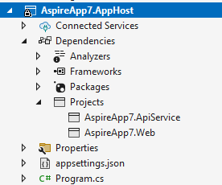

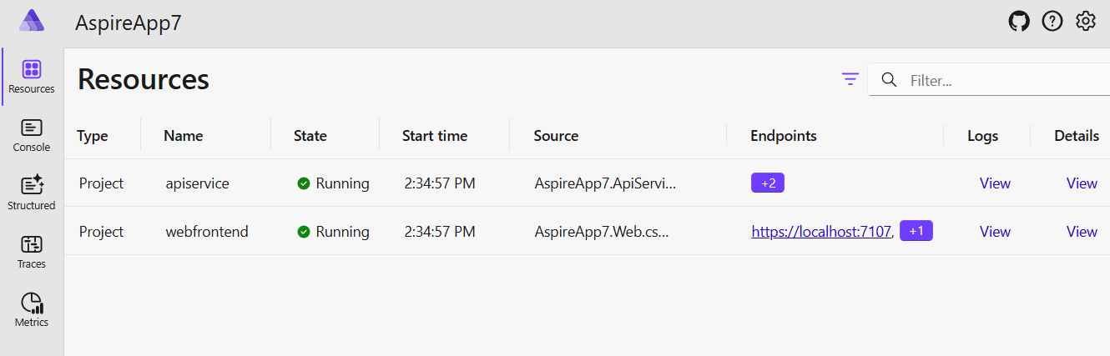
After with .NET Aspire

Slide 129
A cloud ready stack for building observable, production ready, distributed applications
Smart Defaults
Developer Dashboard
Orchestration
Service Discovery
Integrations
Deployment
Notes:
With orchestration, the .NET Aspire app host knows what to start up but we can also configure it so it knows about project dependencies, and it can enable applications to automatically discover each other so we don't have to use hard coded strings.

Slide 130
Service Discovery Before
{
"Logging": {
"LogLevel": {
"Default": "Information",
"Microsoft.AspNetCore": "Warning"
}
},
"AllowedHosts": "*",
"ProductEndpoint": "http://localhost:5228",
"ProductEndpointHttps": "https://localhost:7130"
}
builder.Services.AddHttpClient<ProductService>(c =>
{
var url = builder.Configuration["ProductEndpoint"] ?? throw new
InvalidOperationException("ProductEndpoint is not set");
c.BaseAddress = new(url);
});

Slide 131
Service Discovery
var builder = DistributedApplication.CreateBuilder(args);
var apiService = builder.AddProject<Projects.ApiService>("apiservice");
builder.AddProject<Projects.Web>("webfrontend")
.WithReference(apiService);
builder.Build().Run();
builder.Services.AddHttpClient<WeatherApiClient>(client =>
{
client.BaseAddress = new("https+http://apiservice");
});
Notes:
What we can do is instead of just adding each of our projects to the builder of our distributed application we can actually have the projects reference each other. In this case when I add a project it is returning a resource that I can then add as a reference to other projects so here our web front end is using our API service. And I want to make a special call out here which is that the API service and the web front end have these strings defined and these are specific keys that we can use later as part of service discovery. If we take a look below we have our service that we're adding an HTTP client on and in this case we're setting our base address to be both HTTPS plus HTTP and we're using that API service string that .NET Aspire service discovery will automatically resolve for us when we run our application.

Slide 132
A cloud ready stack for building observable, production ready, distributed applications
Smart Defaults
Developer Dashboard
Orchestration
Service Discovery
Integrations
Deployment
Notes:
Now as we mentioned earlier our application is small today but it is using things such as a database but as our application grows we're going to start to integrate in more services and additional dependencies that we may want to use and that's where .NET Aspire integrations come in.

Slide 133
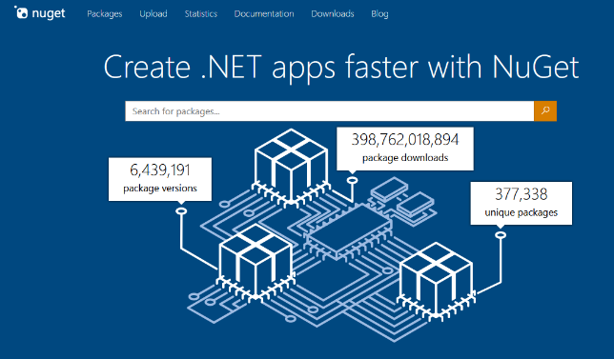
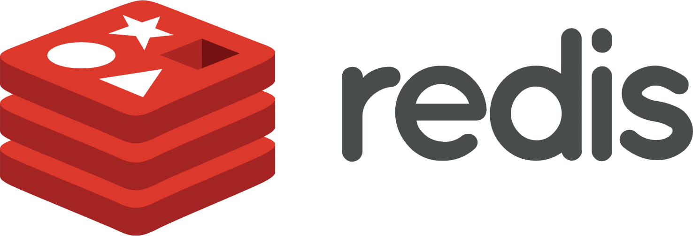





Integrations
Notes:
.NET Aspire integrations are a curated list of optimized libraries that are preconfigured to easily integrate into .NET Aspire app host projects and additionally into .NET projects directly that are being orchestrated with Aspire. So, this thing means things like SQL databases, Cosmos DB Azure integrations, Redis Cache, messaging, and a lot more and all of these are available open source and directly on NuGet. In addition to libraries from Microsoft and for Azure there's great integrations into other ecosystems as well such as AWS.

Slide 134
Automatically will pull down container image and start it in Docker or Podman!
Hosting Integration
var builder = DistributedApplication.CreateBuilder(args); var postgres = builder.AddPostgres("postgres").WithPgAdmin(); var db = postgres.AddDatabase("db");
var cache = builder.AddRedis("cache");
var apiService = builder.AddProject<Projects.ApiService>("apiservice")
.WithReference(db);
builder.AddProject<Projects.Web>("webfrontend")
.WithReference(apiService)
.WithReference(cache);
builder.Build().Run();
Notes:
So how is this different than just adding the client library directly? Well, the first thing is that when you add in the hosting integration package to the app host it gives you single line method calls to easily integrate those services. So, for example, here I'm not only adding a Postges database but I'm also adding a Postges admin tool as well and on top of that I'm adding Redis cache into it and configuring my back end and my front end to automatically use these new dependencies which will go through the service discovery phase.
Now when I run my application .NET Aspire will automatically pull down the container images or any other dependencies required and automatically start them inside of docker or podman. This is a huge save of time where developers getting up and running on their local machine.

Slide 135
Client Integration
var builder = WebApplication.CreateBuilder(args);
builder.AddServiceDefaults();
builder.AddRedisOutputCache("cache");
builder.Services.AddRazorComponents()
.AddInteractiveServerComponents();
var app = builder.Build();
app.UseOutputCache();
app.MapRazorComponents<App>()
.AddInteractiveServerRenderMode();
app.MapDefaultEndpoints();
app.Run();
Configures service with retries, corresponding health checks, logging, and telemetry!!!!
Notes:
Now on top of that there's another package that you integrate directly into your applications so if you want to add caching for example into your back end or your front end you may add in the Redis output caching integration into your Blazor application. Here that's what I've done and I've simply added a single line of code to say add Redis output cache with the same key that I configured earlier so it can go through service discovery. Now these client integrations not just add Redis connectivity into your application but they also use smart defaults such as adding retries health checks logging and additional telemetry that we will be able to visualize into the dashboard.

Slide 136
A cloud ready stack for building observable, production ready, distributed applications
Smart Defaults
Developer Dashboard
Orchestration
Service Discovery
Integrations
Deployment
Notes:
All right finally is the deployment phase of the application because .NET Aspire as I've shown so far gives us a world class development experience and really helps us locally on our machine get deep insights into our application comma but at some time we need to be able to deploy it..

Slide 137













Flexible Integrations & Deployment
How You Do It Today!
AWS CDK
Azure Dev CLI
Visual Studio
Notes:
So what are our options well the first thing is that you can continue to just deploy your application directly like you have been doing today. now it may mean that you need to add a few more connection strings or you may need to add in those dependencies into your deployment pipeline. But no matter where you're deploying your .NET applications today and whatever services you're using you can continue to deploy. In this case I may decide to integrate Azure Redis Cache and continue to deploy my application into App Service. Or I might decide that I want to take it further and I want to use things such as container apps to bundle up application article even further such as using Kubernetes services. But of course, you can deploy your application everywhere.
In addition to how you deploy today there's deep integrations for AWS and for Azure like we've seen with integrations but in additionally into the command line to help you get your services up and running. And of course it wouldn't be Visual Studio with a little right click publish. Visual Studio directly integrates into the Azure developer CLI to give you sort of an easy button to start to deploy your application. Visual Studio on Azure developer CLI can take your application and bundle it up automatically into containers and publish them to Azure Container Apps. Let's take a look and see what that looks like.

Slide 138
New and Upcoming Serverless Compute Enhancements
Serverless Unleashed: From Design Patterns to Azure Solutions and Beyond

Slide 139





Many Hosting Options
Consumption
Premium
Dedicated
Container Apps
Serverless
Sort of Serverless
App Service Plan
Consumption, Dedicated
App Service
Environment
Azure Stack
Functions
Runtime
Azure
IoT Edge
Network Isolation
On Premises
Your Server
On Devices

Slide 140
Many Hosting Options
Consumption
Premium
Dedicated
Container Apps
Flex Consumption
App Service Plan
Azure Stack
Functions Runtime
Azure IoT Edge

Slide 141

#1 Issue in Serverless: Cold Starts

Slide 142
#1 Issue in Serverless: Cold Starts
Premium Functions
Always Ready
Consumption Functions
You wait
Flex Consumption
(Optional) Always Ready
Notes:
Always ready instances
Flex Consumption includes an optional Always Ready feature, that allow you to select instances to be always running and assigned to each of your per-function scale groups or individual functions. This is a great option for scenarios where you need to have a minimum number of instances always ready to handle requests, for example, to reduce your application's cold start latency.

Slide 143
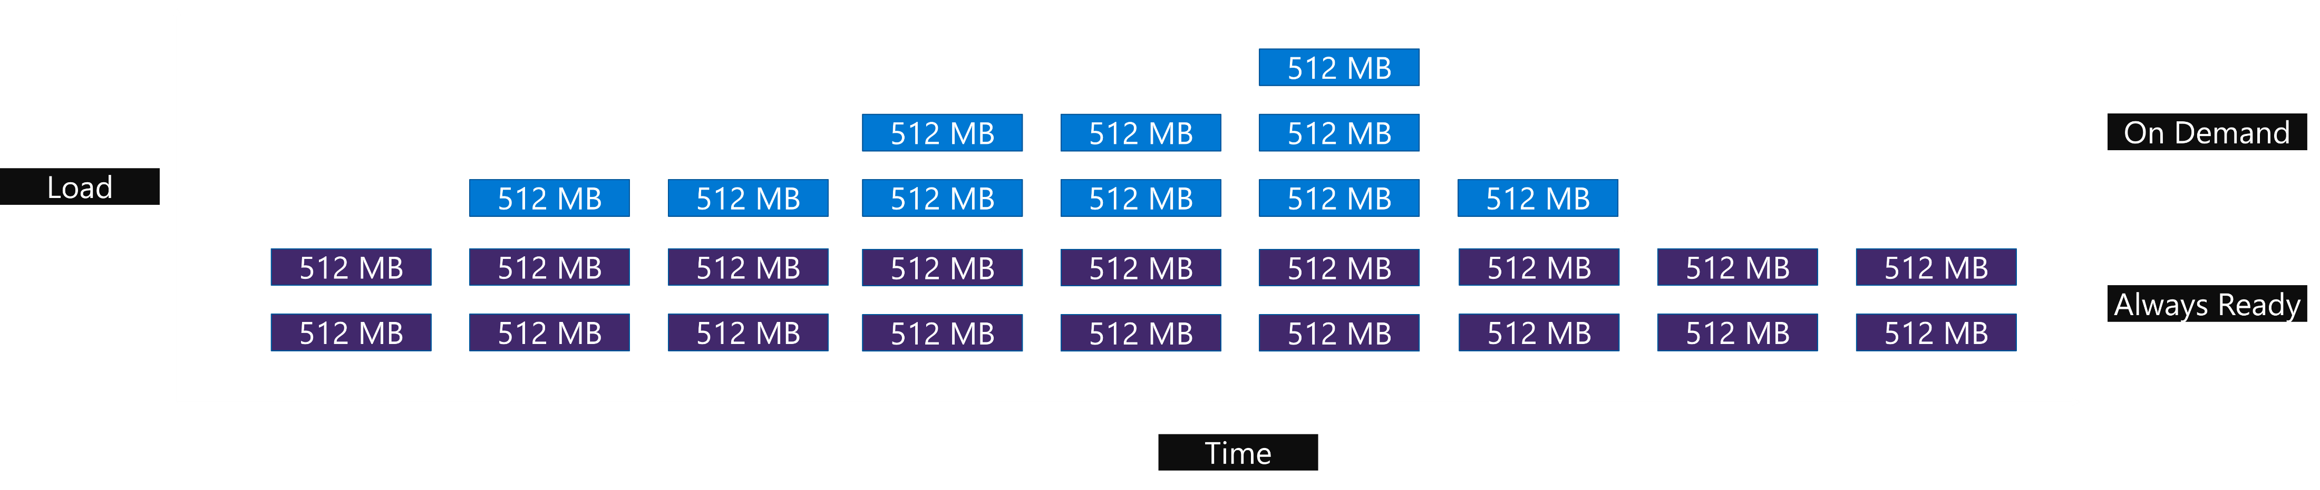
Always Ready Instances
Choose instances that are always running
Set minimum number of instances always ready
Notes:
Flex Consumption includes an Always Ready feature, that allow you to select a number of instances to be always running and assigned to each of your per-function scale groups or functions. This is a great option for scenarios where you need to have a minimum number of instances always ready to handle requests, for example, to reduce your application's cold start latency. The default is 0 (zero).
For example, if you set always ready to 2 for your HTTP group of functions, the platform will keep 2 instances always running and assigned to your app for your HTTP functions in the app. Those instances will be processing your function executions, but depending on concurrency settings, the platform will scale beyond those two instances with on-demand instances.

Slide 144

Virtual Network Support
Notes:
Flex Consumption expands on the traditional benefits of the Consumption plan by adding support for virtual network integration. When your apps run in a Flex Consumption plan, they can connect to other Azure services secured inside a virtual network. This allows you to take advantage of serverless billing and scale, together with the scale and throughput benefits of the Consumption plan.

Slide 145
Virtual Network Support
Inbound Private Endpoints
Virtual Network Integration
Virtual Network Triggers (non-HTTP)
Hybrid connections (Windows only)
Notes:
The VNet integration includes:
Inbound private endpoints
Virtual Network integration
Virtual Network Triggers (non-HTTP)
Hybrid connections (Windows only)
There are no extra costs for VNet support in Flex Consumption.

Slide 146
Instance Memory Choice
2048-Mb and 4096-Mb (more options coming)
Default is 2048-Mb
Change instance memory size at any time
More memory means more can be done
Notes:
In Flex Consumption, there are multiple choices for instance memory size.
The preview starts with 2048 MB and 4096 MB, and more instance sizes will be added in the future.
The default is 2048-Mb
You can change instance memory size at any time
The larger the memory, the more each instance can handle—heavier executions or more concurrency—depending on your workload.

Slide 147
Per-Instance Concurrency
Number of parallel executions
Can set concurrency level per instance
Has a direct effect on how your app scales
Notes:
Concurrency, in the context of function apps, refers to the number of parallel requests (executions) that each instance of your function app can handle.
With Flex Consumption, you can set the number of concurrent functions that will execute within a function app instance regardless of whether the functions are processing HTTP or non-HTTP workloads.
Concurrency directly affects your app's scale because at lower concurrency levels, you need more instances to handle the event-driven demand for a function.

Slide 148
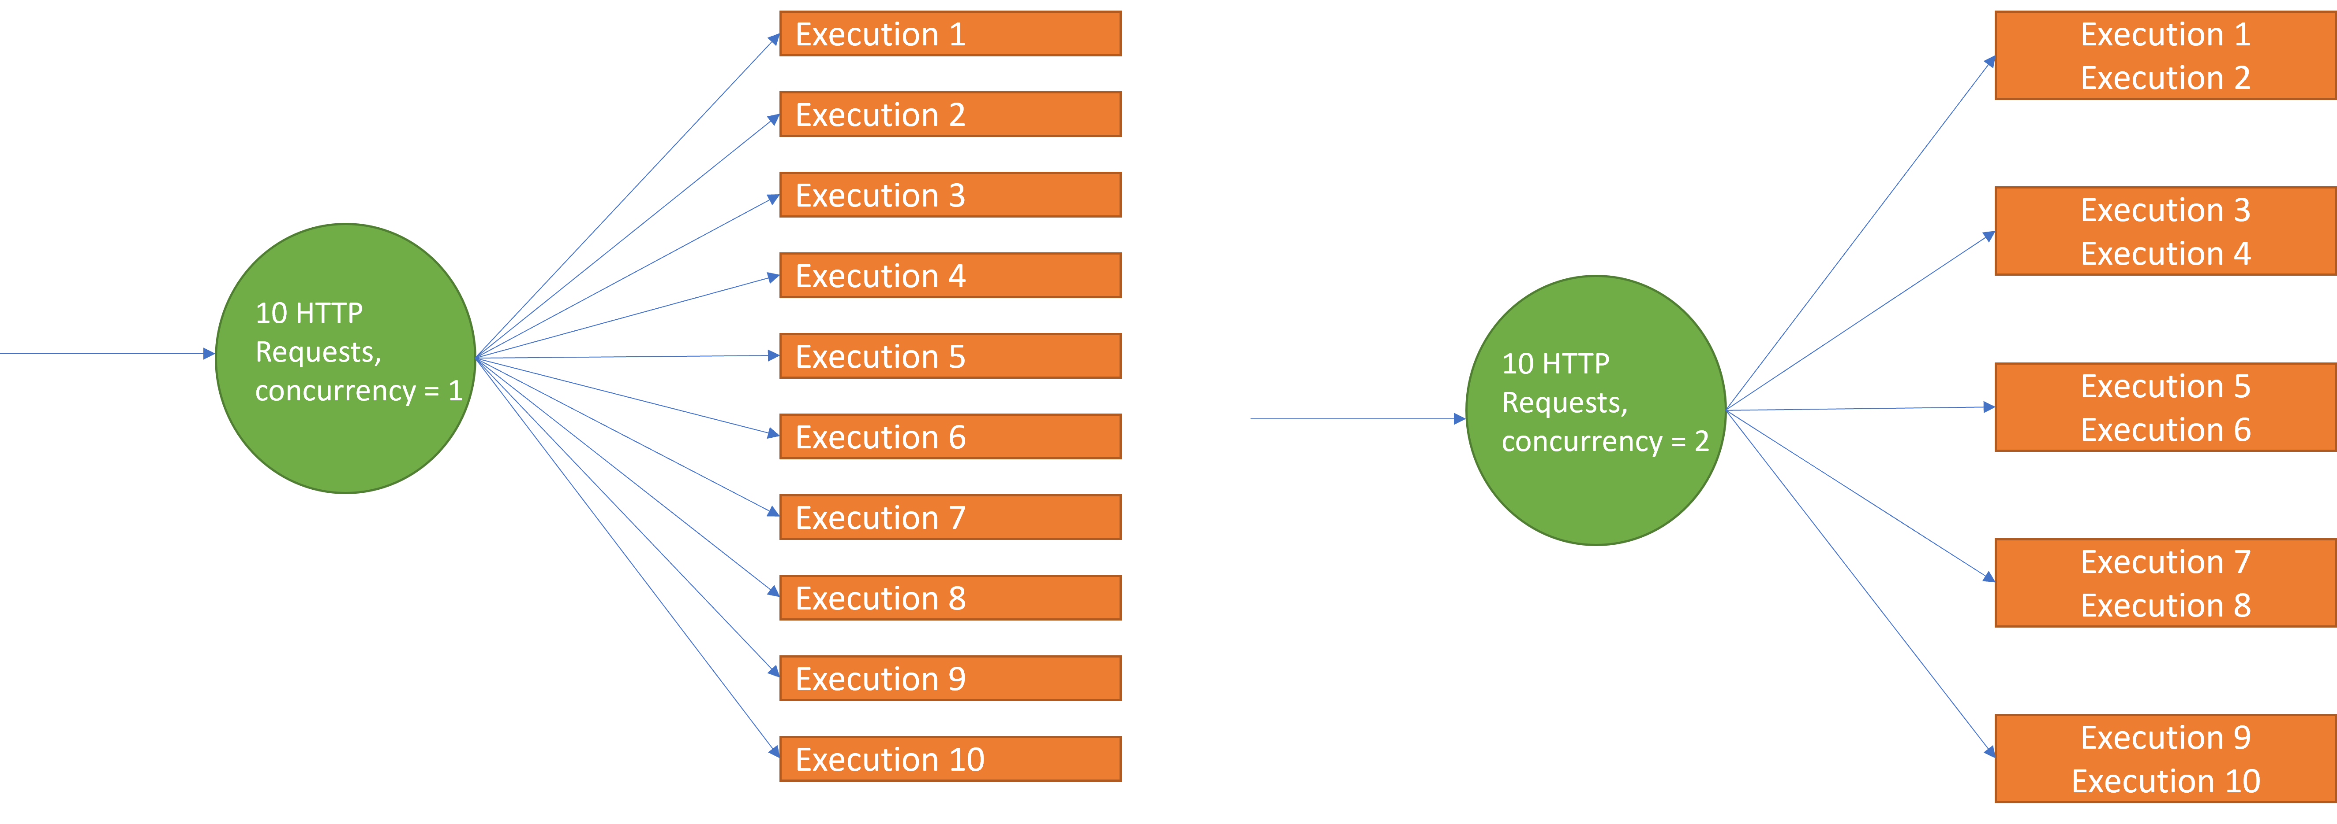
Per-Instance Concurrency

Slide 149
Per-Function Scaling
Deterministic way of scaling your app on a per-function basis
No code changes
Special cases: HTTP, Blob (Event Grid), and Durable trigger
Notes:
Flex Consumption introduces per-function scaling, which scales function groups and individual functions independently without changes to your code. This is an important feature that ensures the deterministic scaling of your app. You don't need to change your code or configuration; per-function scaling will work as a platform feature.
The Flex Consumption plan empowers you to improve the scale performance of your apps with various trigger types. It provides a more deterministic way of scaling your app on a per-function basis, giving you the control you need.
This per-function scaling behavior is a part of the hosting platform, so you do not need to configure you app or change the code.
In per function scaling, HTTP, Blob (Event Grid), and Durable triggers are special cases. All HTTP-triggered functions are grouped and scale together in the same instances, and all Durable triggered functions (Orchestration, Activity, or Entity triggers) are grouped and scale together in the same instances. All other functions in the app are scaled individually.

Slide 150
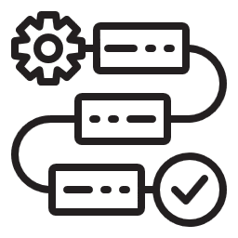

Per-Function Scaling
Deterministic way of scaling your app on a per-function basis
No code changes
Special cases: HTTP, Blob (Event Grid), and Durable trigger
Function 1
Function 2
Function 3
Function 4
Function 6
Function 7
Function 8
Notes:
HTTP triggered functions Function 1 and Function 2 will have their own instances and scale together
Durable triggered functions Function 3 and Function 4 will have their own instances and scale together accordingly
Service Bus trigger Function 5 will have its own instances and scale by itself
Service Bus trigger Function 6 will have its own instances and scale by itself
Event Hubs trigger Function 7 will have its own instances ands cale by itself

Slide 151
Scale Out Further
Default is 100 instances
Highest is 1000 instances
Region Subscription Memory Quota
512,000 MB per region per subscription
Notes:
The default scale limit set by client tools is 100, which can be changed up to 1000 instances per app. Regular consumption function apps are restricted to a maximum of 200 instances.
Consideration:
During the public preview of Flex Consumption, each region in a given subscription has a memory limit of 512,000 MB (512 GB) for all instances of apps running on Flex Consumption in that region. This means each Azure Subscription can have, simultaneously in each region, a maximum of 250 instances at 2048 MB, 125 instances at 4096 MB, or any other combination of instance sizes and counts that is under 512,000 MB of total memory in the region. This information ensures you are fully informed about the maximum instance configurations.

Slide 152
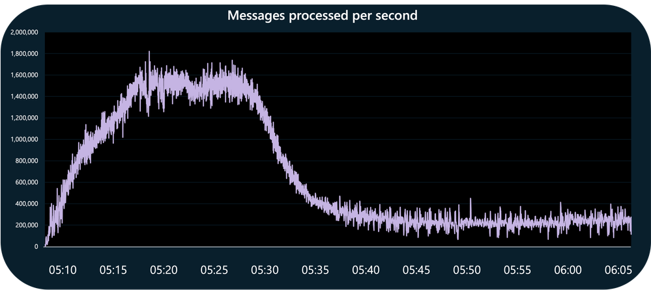
Extreme Scalability
Notes:
In a recent large-scale test, GitHub was able to sustain nearly 1.6 million events processed per second using one Flex Consumption app triggering from a network restricted Event Hub

Slide 153
Even More Benefits
Azure Load Testing Integration
Open Telemetry Opt-In
Long Execution Times
Notes:
Azure Load Testing Integration
For all Function Apps, you should see a Performance section in the Azure portal, with a Load Testing option that lets you easily set up a load test against your HTTP-based functions. This is a great option for testing your HTTP workloads for Flex Consumption. Soon, there will be a Performance Tuner specific for Flex Consumption.
Open Telemetry Opt-In
Flex consumption apps can opt-in to emit platform logs, metrics, and traces using Open Telemetry semantics to Azure Application Insights or other OLTP-compliant endpoints. Configuring your Function worker code to do the same is also easy.
Long Execution Times
In Flex Consumption, the host does not enforce an execution time limit.

Slide 154
Demonstration of Extreme Scalability using Azure Functions Flex Consumption

Slide 155
Flex Consumption Features and Benefits
Always Ready
Virtual Network Support
Instance Memory Choice
Per-Instance Concurrency
Per-Function Scaling
Scale-Out Further
Extreme Scalability
Azure Load Testing Integration
Open Telemetry Opt-In
Long Execution Times
Pricing

Slide 156
Pricing
On-Demand
Always Ready
Meter | Free Grant (per month) | Pay as you go
On Demand Execution Time | 100,000 GB-s | $0.000016/GB-s
On Demand Total Executions | 250,000 executions | $0.20 per million executions
Always Ready Baseline |  | $0.000004/GB-s
Always Ready Execution Time |  | $0.000009/GB-s
Always Ready Total Executions |  | $0.20 per million executions
Notes:
When creating your plan you can choose from a list of memory instance sizes. Azure Functions flex consumption plan is billed based on two modes:
On Demand – event driven instances scaled based on configured per instance concurrency. Billed only when instances are executing functions, with no minimum instance count required. You will be billed for the total amount of memory provisioned while each On-Demand instance is executing functions, and for the total number of executions.
Always Ready – an optional number of instances that can be configured to be always enabled and assigned to different triggers and functions of the app. You will be billed for the total amount of memory provisioned for a baseline while each Always Ready instance is idle; for the total amount of memory provisioned for the execution time each Always Ready instance is executing functions; and for the total number of executions.

Slide 157
Pricing
My Standard Scenario
3 million executions per month; each execution using 512 Mb and running for 1 second
Consumption: $18.00
Notes:
Normal Scenario
3 Million Executions per month
Each execution taking 1-second and using 512-Mb
$18.00 per month

Slide 158
Pricing
Azure Function Scenario
3 million executions per month; each execution using 512 MB and running for 1 second
Consumption: $18.00
Premium: $155.27
Flex Consumption (w/o Always Ready): $20.60
Notes:
Scenario (without Always Ready)
3-Million Executions per month
Each execution taking 1-second and using 2048-Mb
Additional Always Ready Parameters
Azure Function App idle 25% of the day
25% (750,000) of the executions performed during idle

Slide 159
Pricing
Flex Consumption with Always Ready Scenario
3 million executions per month; each execution using 512 MB and running for 1 second; 1% of executions performed while idle
Consumption: $18.00
Premium: $155.27
Flex Consumption (w/o Always Ready): $20.60
Flex Consumption (with Always Ready): $33.70
Notes:
Scenario (without Always Ready)
3-Million Executions per month
Each execution taking 1-second and using 2048-Mb
Additional Always Ready Parameters
Azure Function App idle 25% of the day (182.5-hour/month)
1% (30,000) of the executions performed during idle

Slide 160
Pricing
Actual Scenario
434k executions per month; each execution using 2048 MB and running for 400 milliseconds; VNet connectivity needed no Always Ready (cold starts acceptable)
Consumption: N/A
Premium: $155.27
Flex Consumption: $4.16
Notes:
Scenario (without Always Ready)
3-Million Executions per month
Each execution taking 1-second and using 2048-Mb
Additional Always Ready Parameters
Azure Function App idle 25% of the day
25% (750,000) of the executions performed during idle

Slide 161
Recap
Serverless Unleashed: From Design Patterns to Azure Solutions and Beyond

Slide 162
Recap
Serverless Architecture
Introduction to Serverless Computing
Serverless Architecture Styles
Cloud Design Patterns
Software Design Patterns

Slide 163


Agenda
Serverless Architecture
Azure Services Offerings
Compute
Workflow and Integration
Data Processing and Analytics
Messaging
Data Storage
Notes:
Compute
Workflow and Integration
Data Processing and Analytics
Messaging
Data Storage

Slide 164
Recap
Serverless Architecture
Azure Services Offerings
What’s New and Coming
Azure Functions on Azure Container Apps
.NET Aspire
Azure Functions Flex Consumption

Slide 165






Thank You
chadgreen@chadgreen.com
TaleLearnCode
ChadGreen.com
ChadGreen
ChadwickEGreen

